Slide 1
3D XY Model
with
Wolff Cluster Update
Nathan Lydick
Computational Physics (Physics 514)
December 8, 2020

Slide 2


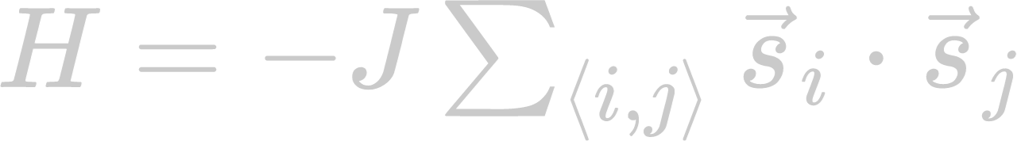
XY Model
Ising Model has Hamiltonian:
or, with nearest neighbors and a constant J:
The XY Model extends this with 2D (hence XY) spins instead of 1D spins
The models exist on a discrete grid, which could have any of a number of lattices.
I modeled a cubic grid, with periodic boundary conditions.

Slide 3
Review: Metropolis Algorithm
Initialize the Grid
For a given number of steps
Select a point
Looking at the neighbors, total up the energy change dH if we flipped the spin at that point
If the change in energy is negative, accept it
If the change is positive, accept it with probability e^{-βdH}
Recalculate the energy and magnetization

Slide 4
Wolff Update
Initialize the Grid
For a given number of steps
Select a point, and add it to a set of points to be added to the cluster (the frontier)
For every point in the frontier:
Add the point to the cluster, remove from frontier
Consider every neighbor not in the cluster
If the spins are aligned, add the neighbor to the frontier with probability 1-e^{-2βJ}
Note: If the spins are not aligned, not adding it to the cluster will decrease the energy at this pair when we flip the spin
Flip the spin
Recalculate the energy and magnetization
+ | - | + | + | -
- | + | + | - | -
- | + | + | - | -
- | - | + | + | +
+ | - | - | + | -

Slide 5
Wolff Update
Initialize the Grid
For a given number of steps
Select a point, and add it to a set of points to be added to the cluster (the frontier)
For every point in the frontier:
Add the point to the cluster, remove from frontier
Consider every neighbor not in the cluster
If the spins are aligned, add the neighbor to the frontier with probability 1-e^{-2βJ}
Note: If the spins are not aligned, not adding it to the cluster will decrease the energy at this pair when we flip the spin
Flip the spin
Recalculate the energy and magnetization
+ | - | + | + | -
- | + | + | - | -
- | + | + | - | -
- | - | + | + | +
+ | - | - | + | -

Slide 6
Wolff Update
Initialize the Grid
For a given number of steps
Select a point, and add it to a set of points to be added to the cluster (the frontier)
For every point in the frontier:
Add the point to the cluster, remove from frontier
Consider every neighbor not in the cluster
If the spins are aligned, add the neighbor to the frontier with probability 1-e^{-2βJ}
Note: If the spins are not aligned, not adding it to the cluster will decrease the energy at this pair when we flip the spin
Flip the spin
Recalculate the energy and magnetization
+ | - | + | + | -
- | + | + | - | -
- | + | + | - | -
- | - | + | + | +
+ | - | - | + | -

Slide 7
Wolff Update
Initialize the Grid
For a given number of steps
Select a point, and add it to a set of points to be added to the cluster (the frontier)
For every point in the frontier:
Add the point to the cluster, remove from frontier
Consider every neighbor not in the cluster
If the spins are aligned, add the neighbor to the frontier with probability 1-e^{-2βJ}
Note: If the spins are not aligned, not adding it to the cluster will decrease the energy at this pair when we flip the spin
Flip the spin
Recalculate the energy and magnetization
+ | - | + | + | -
- | + | + | - | -
- | + | + | - | -
- | - | + | + | +
+ | - | - | + | -

Slide 8
Wolff Update
Initialize the Grid
For a given number of steps
Select a point, and add it to a set of points to be added to the cluster (the frontier)
For every point in the frontier:
Add the point to the cluster, remove from frontier
Consider every neighbor not in the cluster
If the spins are aligned, add the neighbor to the frontier with probability 1-e^{-2βJ}
Note: If the spins are not aligned, not adding it to the cluster will decrease the energy at this pair when we flip the spin
Flip the spin
Recalculate the energy and magnetization
+ | - | + | + | -
- | + | + | - | -
- | + | - | - | -
- | - | + | + | +
+ | - | - | + | -

Slide 9
Wolff Update
Initialize the Grid
For a given number of steps
Select a point, and add it to a set of points to be added to the cluster (the frontier)
For every point in the frontier:
Add the point to the cluster, remove from frontier
Consider every neighbor not in the cluster
If the spins are aligned, add the neighbor to the frontier with probability 1-e^{-2βJ}
Note: If the spins are not aligned, not adding it to the cluster will decrease the energy at this pair when we flip the spin
Flip the spin
Recalculate the energy and magnetization
+ | - | + | + | -
- | + | + | - | -
- | + | - | - | -
- | - | + | + | +
+ | - | - | + | -

Slide 10
Wolff Update
Initialize the Grid
For a given number of steps
Select a point, and add it to a set of points to be added to the cluster (the frontier)
For every point in the frontier:
Add the point to the cluster, remove from frontier
Consider every neighbor not in the cluster
If the spins are aligned, add the neighbor to the frontier with probability 1-e^{-2βJ}
Note: If the spins are not aligned, not adding it to the cluster will decrease the energy at this pair when we flip the spin
Flip the spin
Recalculate the energy and magnetization
+ | - | + | + | -
- | + | + | - | -
- | + | - | - | -
- | - | + | + | +
+ | - | - | + | -

Slide 11
Wolff Update
Initialize the Grid
For a given number of steps
Select a point, and add it to a set of points to be added to the cluster (the frontier)
For every point in the frontier:
Add the point to the cluster, remove from frontier
Consider every neighbor not in the cluster
If the spins are aligned, add the neighbor to the frontier with probability 1-e^{-2βJ}
Note: If the spins are not aligned, not adding it to the cluster will decrease the energy at this pair when we flip the spin
Flip the spin
Recalculate the energy and magnetization
+ | - | + | + | -
- | + | - | - | -
- | + | - | - | -
- | - | + | + | +
+ | - | - | + | -

Slide 12
Wolff Update
Initialize the Grid
For a given number of steps
Select a point, and add it to a set of points to be added to the cluster (the frontier)
For every point in the frontier:
Add the point to the cluster, remove from frontier
Consider every neighbor not in the cluster
If the spins are aligned, add the neighbor to the frontier with probability 1-e^{-2βJ}
Note: If the spins are not aligned, not adding it to the cluster will decrease the energy at this pair when we flip the spin
Flip the spin
Recalculate the energy and magnetization
+ | - | + | + | -
- | + | - | - | -
- | + | - | - | -
- | - | + | + | +
+ | - | - | + | -

Slide 13
Wolff Update
Initialize the Grid
For a given number of steps
Select a point, and add it to a set of points to be added to the cluster (the frontier)
For every point in the frontier:
Add the point to the cluster, remove from frontier
Consider every neighbor not in the cluster
If the spins are aligned, add the neighbor to the frontier with probability 1-e^{-2βJ}
Note: If the spins are not aligned, not adding it to the cluster will decrease the energy at this pair when we flip the spin
Flip the spin
Recalculate the energy and magnetization
+ | - | + | + | -
- | + | - | - | -
- | + | - | - | -
- | - | + | + | +
+ | - | - | + | -

Slide 14
Wolff Update
Initialize the Grid
For a given number of steps
Select a point, and add it to a set of points to be added to the cluster (the frontier)
For every point in the frontier:
Add the point to the cluster, remove from frontier
Consider every neighbor not in the cluster
If the spins are aligned, add the neighbor to the frontier with probability 1-e^{-2βJ}
Note: If the spins are not aligned, not adding it to the cluster will decrease the energy at this pair when we flip the spin
Flip the spin
Recalculate the energy and magnetization
+ | - | + | + | -
- | + | - | - | -
- | + | - | - | -
- | - | - | + | +
+ | - | - | + | -

Slide 15
Wolff Update
Initialize the Grid
For a given number of steps
Select a point, and add it to a set of points to be added to the cluster (the frontier)
For every point in the frontier:
Add the point to the cluster, remove from frontier
Consider every neighbor not in the cluster
If the spins are aligned, add the neighbor to the frontier with probability 1-e^{-2βJ}
Note: If the spins are not aligned, not adding it to the cluster will decrease the energy at this pair when we flip the spin
Flip the spin
Recalculate the energy and magnetization
+ | - | + | + | -
- | + | - | - | -
- | + | - | - | -
- | - | - | + | +
+ | - | - | + | -

Slide 16
Wolff Update
Initialize the Grid
For a given number of steps
Select a point, and add it to a set of points to be added to the cluster (the frontier)
For every point in the frontier:
Add the point to the cluster, remove from frontier
Consider every neighbor not in the cluster
If the spins are aligned, add the neighbor to the frontier with probability 1-e^{-2βJ}
Note: If the spins are not aligned, not adding it to the cluster will decrease the energy at this pair when we flip the spin
Flip the spin
Recalculate the energy and magnetization
+ | - | + | + | -
- | + | - | - | -
- | + | - | - | -
- | - | - | + | +
+ | - | - | + | -

Slide 17
Wolff Update
Initialize the Grid
For a given number of steps
Select a point, and add it to a set of points to be added to the cluster (the frontier)
For every point in the frontier:
Add the point to the cluster, remove from frontier
Consider every neighbor not in the cluster
If the spins are aligned, add the neighbor to the frontier with probability 1-e^{-2βJ}
Note: If the spins are not aligned, not adding it to the cluster will decrease the energy at this pair when we flip the spin
Flip the spin
Recalculate the energy and magnetization
+ | - | + | + | -
- | - | - | - | -
- | + | - | - | -
- | - | - | + | +
+ | - | - | + | -

Slide 18
Wolff Update
Initialize the Grid
For a given number of steps
Select a point, and add it to a set of points to be added to the cluster (the frontier)
For every point in the frontier:
Add the point to the cluster, remove from frontier
Consider every neighbor not in the cluster
If the spins are aligned, add the neighbor to the frontier with probability 1-e^{-2βJ}
Note: If the spins are not aligned, not adding it to the cluster will decrease the energy at this pair when we flip the spin
Flip the spin
Recalculate the energy and magnetization
+ | - | + | + | -
- | - | - | - | -
- | + | - | - | -
- | - | - | + | +
+ | - | - | + | -

Slide 19
Wolff Update
Initialize the Grid
For a given number of steps
Select a point, and add it to a set of points to be added to the cluster (the frontier)
For every point in the frontier:
Add the point to the cluster, remove from frontier
Consider every neighbor not in the cluster
If the spins are aligned, add the neighbor to the frontier with probability 1-e^{-2βJ}
Note: If the spins are not aligned, not adding it to the cluster will decrease the energy at this pair when we flip the spin
Flip the spin
Recalculate the energy and magnetization
+ | - | + | + | -
- | - | - | - | -
- | + | - | - | -
- | - | - | + | +
+ | - | - | + | -

Slide 20
Wolff Update
Initialize the Grid
For a given number of steps
Select a point, and add it to a set of points to be added to the cluster (the frontier)
For every point in the frontier:
Add the point to the cluster, remove from frontier
Consider every neighbor not in the cluster
If the spins are aligned, add the neighbor to the frontier with probability 1-e^{-2βJ}
Note: If the spins are not aligned, not adding it to the cluster will decrease the energy at this pair when we flip the spin
Flip the spin
Recalculate the energy and magnetization
+ | - | + | + | -
- | - | - | - | -
- | - | - | - | -
- | - | - | + | +
+ | - | - | + | -

Slide 21
Wolff Update
Initialize the Grid
For a given number of steps
Select a point, and add it to a set of points to be added to the cluster (the frontier)
For every point in the frontier:
Add the point to the cluster, remove from frontier
Consider every neighbor not in the cluster
If the spins are aligned, add the neighbor to the frontier with probability 1-e^{-2βJ}
Note: If the spins are not aligned, not adding it to the cluster will decrease the energy at this pair when we flip the spin
Flip the spin
Recalculate the energy and magnetization
+ | - | + | + | -
- | - | - | - | -
- | - | - | - | -
- | - | - | + | +
+ | - | - | + | -

Slide 22
XY Model with Wolff Update
Map the XY model to an Ising model at each MC step by selecting a random direction vector r to be “up” for that step.
Each XY spin is mapped to ±1 by taking the sign of the dot product with r
J_{ij} is set to be the absolute value of the product of the “up” components of neighboring spins, multiplied by the overall coupling constant J
Flipping the spin is now done by reflecting along the vector r (i.e. reflecting over the plane normal to the vector)

Slide 23
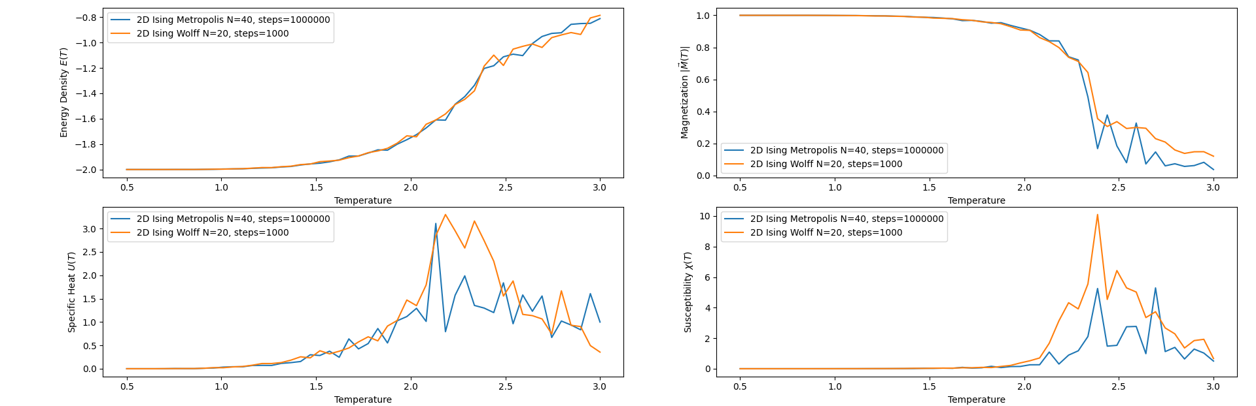
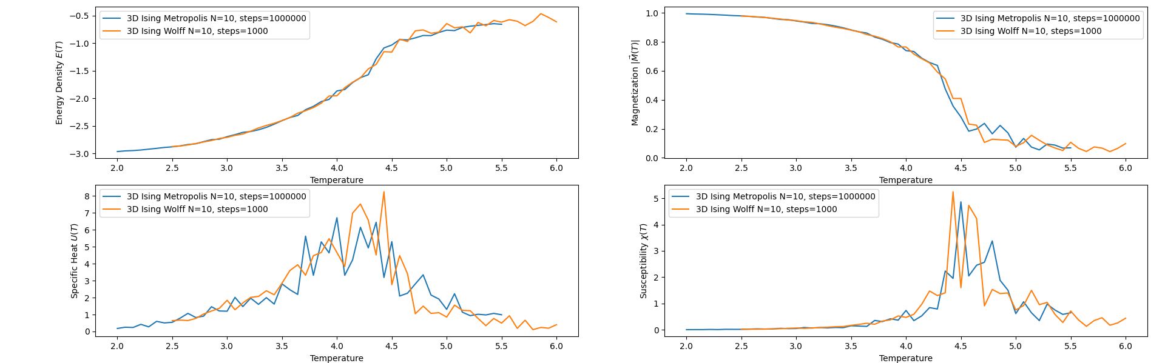
Metropolis
Ising Model
Comparison
2D -------->
3D--------->

Slide 24
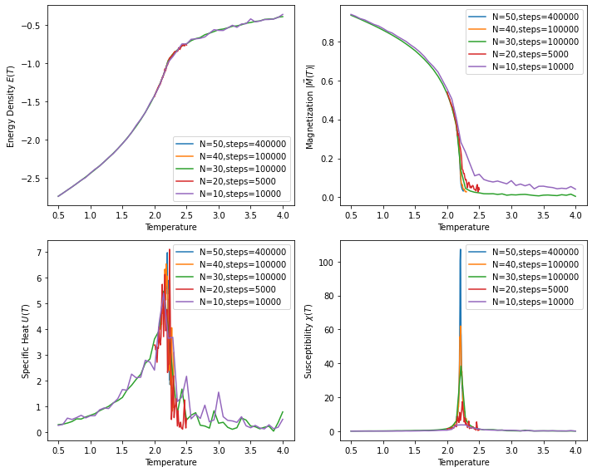
XY + Wolff
Results

Slide 25
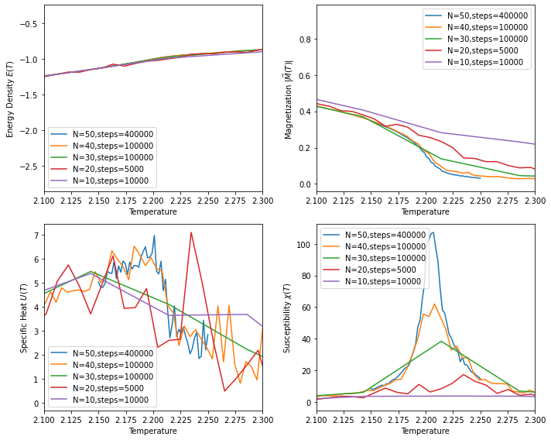
XY + Wolff
Results

Slide 26
References
"Simulation methods in physics: Lecture 4: Cluster Update Algorithms" by Kari Rummukainen https://www.mv.helsinki.fi/home/rummukai/simu/cluster.pdf
"Critical Behaviour of the 3D XY-Model:A Monte Carlo Study" by Aloysius P. Gottlob and Martin Hasenbusch (1993): arXiv:cond-mat/9305020 (https://arxiv.org/pdf/cond-mat/9305020.pdf)
"High-precision Monte Carlo study of several models in the three-dimensional U(1) universality class" by Wanwan Xu, Yanan Sun, Jian-Ping Lv, Youjin Deng (2019): arXiv:1908.10990 [cond-mat.stat-mech] (https://arxiv.org/pdf/1908.10990.pdf
“Cluster Monte Carlo algoirthms” by Werner Krauth (2008): arXiv:cond-mat/0311623 (https://arxiv.org/pdf/cond-mat/0311623.pdf)

Slide 27
Questions?

